Slide 1
HIGHER EDUCATION – ISSUES AND CHALLENGES
PROF. DR. SATYENDRA PATNAIK
RECTOR
KIIT UNIVERSITY INDIA

Slide 2
WHAT IS EDUCATION
An act or process of imparting or acquiring knowledge, developing the powers of reasoning and judgment, preparing oneself or others intellectually for mature life.
Development of abilities of the mind
Suggests information acquired, an aspiration towards and appreciation of high intellectual and esthetic ideals.

Slide 3
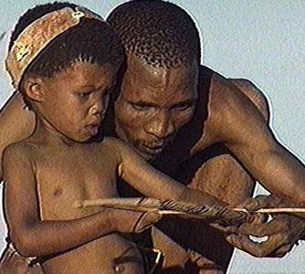
THE PROCESS STILL CONTINUES
The process has been continuing since the dawn of civilization. Adults must have trained the young in knowledge and skill.
The evolution of civilization depended largely on the practice of transmitting knowledge.

Slide 4
THE FORMAL EDUCATION
What we discuss is just a part of the whole process.
It can be called Formal or structured education. It is a set pattern which we try to follow and evaluate children accordingly.
There are various levels in this pattern.

Slide 5
LEVELS OF EDUCATION
Elementary - What is being taught to small children.
Secondary - The next level for children from 6 – 16 years (in school).
Higher Secondary – The Post-School education in colleges, higher institutions and universities.
It is also called Tertiary education given in colleges, universities, technical institutes, professional course delivery schools.
This education usually culminates in the receipt of Certificate, Degrees and Diplomas.

Slide 6
NON-DEGREE EDUCATION
There are agreements and disagreements what constitute higher education.
Should it be only restricted to getting only Degrees, Diplomas.
If so, what about non-Degree courses.

Slide 7
WHO DETERMINES EDUCATION
There has been rapid changes in every field.
The world is now under the grip of the most powerful economic order. Economic power has been determining almost everything including higher education.
With the growth of IT, the higher education scenario is fast changing.
Expanding role of WTO in determining the trends of world economy cast its shadow on higher education.

Slide 8
CHANGES BY ICT REVOLUTION
Information at the press of a button.
ICT revolution has changed the way world behaves and thinks.
School children access the Internet for homework. Academicians have started skipping libraries. They access to read, print, save or to forward it to others.
Class room teachings are on the wane.
Teachers prefer online teaching and students – teacher get connected through e-mails.

Slide 9
THE HUMAN TOUCH
Traditional Universities still continue with interactive classrooms.
Helps developing a personal bond.
On-line courses, chat-room discussions might prove rewarding but it is individual perception.
On line transaction and on-line interaction lack the human approach.

Slide 10
EDU BUSINESS
Human values and emotions have changed.
Higher education is now a global business, hence state control and regulation being limited.
More a commercialized affair as higher education market growing by 9% per annum since 1990s.
The annual fee income was almost $30 billion (Economist Survey on H E 2003).
Though private players have entered in a big way some countries including India still control the fee structure.
To make up financial loss, some Universities openly soliciting entry of foreign students, tailored their courses to international requirements.
Appoint agents and resort to publicity.

Slide 11
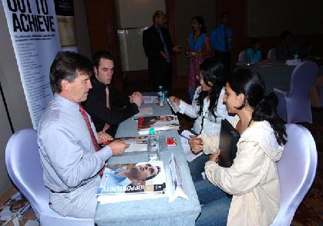
STUDENTS AS CUSTOMERS
Students are reduced to customers or clients.
Globalization helped Universities to go beyond their boundaries.
US, British and Australian Universities setting up campuses in many countries.
Many Universities are collaborating or franchising to teach under their brand name without getting involved teaching.

Slide 12
A NEW & SUBVERSIVE CONCEPT
The idea of the student as consumer is rather a new and subversive concept.
In the past centuries government was the customer for it wanted nation’s brains to be educated. Then Universities were temples of learning.
The system today facing a transition. The change to become market is definitely messy and painful.

Slide 13
REVENUE FROM EDU BUSINESS
NAFSA – Association of International Educators estimates that foreign students contributed $18.78 billions US dollars to US economy (2009-2010).
Universities UK report published in 2009 states, the UK economy received £5 billion in 2008.
Education is a trillion Dollar industry worldwide. So players want more international deregulations.

Slide 14
PRIVATE PLAYERS IN EDU-BUSINESS
Private companies like Kaplan, BPP and Apollo group already run it.
Kaplan that runs Washington Post owns a big educational company.
BPP has deals with British Universities.
Apollo owns University of Phoenix.
Universitas 21 Global – sixteen Universities together have a joint venture of $50 million in collaboration with Thomson Corporation.
Even in India more and more corporate houses are opening up Universities and institutes of higher learning.

Slide 15
WHAT IS EDUCATION THEN ?
With more and more business houses entering Higher education business the fundamental question before us:
Is Higher education a marketable commodity like a fast moving consumer goods product.
Or is it a service like water or electric supply?

Slide 16
PUBLIC GOOD OR COMMERCIAL SERVICE
Academic community would like higher education to be viewed as public good.
WTO believes it is akin to ‘Private Consumption’ directly benefitting the consumer by way of higher income.
The III Summit of Iberian and Latin American Universities 2003 adopted a declaration stating education as a public good and requested governments not to make any commitments to WTO.
But the perception is fast changing.

Slide 17
OPPOSITE VIEW
World Conference on ‘Higher Education in 21st Century : Vision and Action, held at UNESCO Head Quarters in Paris (1998) adopted an Action Plan for reforms in the field of Higher education.
Higher education shall be equally accessible to all on the basis of merit keeping in mind Universal Declaration of Human Rights.
It further declared that Higher education would uphold education’s role of service to society.

Slide 18
CONFLICT OF IDEAS
Academic community has not reacted positively to commercialization.
Governments of many developed countries view it as an opportunity like UK exporting services to Russia, Ukraine and many other countries.
Wi gan and Leigh has students in 26 countries including 10 campuses in India.
UK and US Universities have franchised operations with other institutions outside US and UK.

Slide 19
INDIAN SCENARIO AND INDIAN GRADUATES
Higher education Policy of 1950 has started showing signs of improvement.
Doctors trained in India have been the backbone of the British Medical service.
Engineers IIT graduates plenty in US created 150,000 jobs and $80 billion market capitalization (2005).
Lot of appreciation in US.

Slide 20
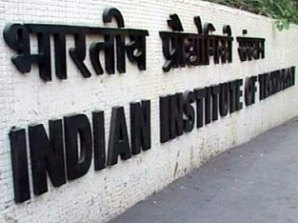
COMPARISON
Virginia and Maryland declared May 2005 as IIT-American Heritage Month.
55 US Members of House of Representatives co-sponsored Resolution 227 honouring IIT Graduates’ innovation to US economy.
With Bangalore alone has more software engineers compared to Silicon Valley, the top 50 global IT service firms only target India for quality manpower.
India only second to US has more certified software professionals - 30 times larger than Germany, hundred times larger than China.
Leading US IT firms have their CMM (Capability Maturity Model) level 5 certification in India rather than in US.

Slide 21
ADVANTAGE INDIA
High technology leadership of the US under threat from India. IBM cut its job in the US and Europe and recruit more in India.
Indian R&D Centres of BELL laboratories, the world’s largest research organization, filed more patents than the US labs (2006).
In 2006 in the month of August alone India announced 1312 applications for drug patents which is 25% higher than Germany and much ahead of Britain and Japan.
Leading finance establishment like Mc Kinsey & Co., A. T. Kearney Inc. have shifted most of their research to India so also J. P. Morgan, Moral Stanley, Deutsche Bank, etc. have shifted most of the research to India.

Slide 22
HEALTH SECTOR
In health sector, the story is almost same.
India to earn $2 Billion a year by 2012.
Indian Medical Schools and Hospitals receive more than 150,000 foreign patients annually, thus emerging as most sought after medical destination.
The cost of the best treatment is almost 25% of the cost for the same in US and UK.
Even in fundamental research India has been doing exceptionally well. GE has announced a huge shifting of research projects from US to India.

Slide 23
INDIA THE FAVOURED DESTINATION
India is moving forward very fast.
Holds about 90% of outsourcing business of $80 Billion US.
It is no wonder then, US President during his visit to India in November 2010 asked for job creation in his country through India’s help.

Slide 24
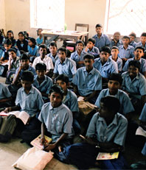
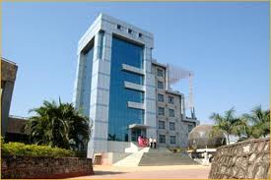
THE PARADOX
Despite all the advantages India still stands at a crossroad.
Excessive bureaucratization and government interference in its education policy.
Large number of students still outside the higher education arena. The scenario is changing but it will take time for a complete turn around.
In spite of all these India still has emerged a global education and research hub.
Public spending has increased on budgetary allocation has been made.

Slide 25
WHAT IS THE REAL GAME
It is true that economically the country gains by making University education commercialized but we still believe Universities must incorporate values and ethics in the curriculum.
In my University we have successfully experimented this.

Slide 26
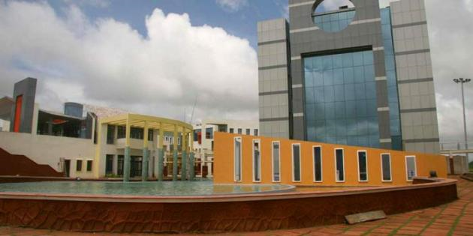
Established in 1992 with $100 by a not so rich individual coming from a very poor financial background, Dr. Achyuta Samanta.
The fastest growing University in India now amongst 15 top Universities.
Huge infrastructure, 17,000 students.
Imparting quality knowledge in Engineering, Medical Sciences, Dentistry, Law, Computers, Biotechnology, Management studies and many other subjects.

Slide 27
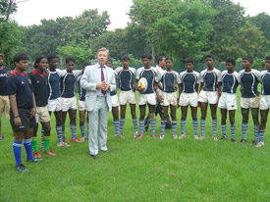
HUMANE FACE OF THE UNIVERSITY - KISS
The uniqueness of this University is it support to KISS.
KISS provides accommodation, food, healthcare and education from Kindergarten to Post-Graduation to 12,000 poorest of the poor underprivileged aborigine children absolutely free.
I would like to inform this august gathering here that this 12000 children are drawn from the poorest of the poor families of underprivileged section of the society who continue to live in abject poverty and in relative isolation away from our so called ‘civilized world’.
World Organizations UNESCO, UNICEF, UNFPA and US Federal Government have joined hands.

Slide 28
APPEAL
I take this opportunity to appeal to each one of you to help and support us in creating an equitable world sans poverty, hunger and ignorance.

Slide 29
CHALLENGES
Time has come to know the challenges.
What are our most important values?
Should it be only confined to only academic freedom, openness to ideas, rigorous study and research?
Should it be only faculty governance and faculty management.

Slide 30
CONCLUSION
From our experiment we can say that the biggest challenge before Higher Education today is not creating financial wealth for the country but to enrich the Human Resource living beyond ‘Our Civilization’.
We need to integrate human values in our education.

Slide 31
THANK YOU
tesekkur ederim

