Slide 1
Internatıonal Black Sea Unıversıty and Educatıon reform
Natela Doghonadze
IBSU Georgıa

Slide 2
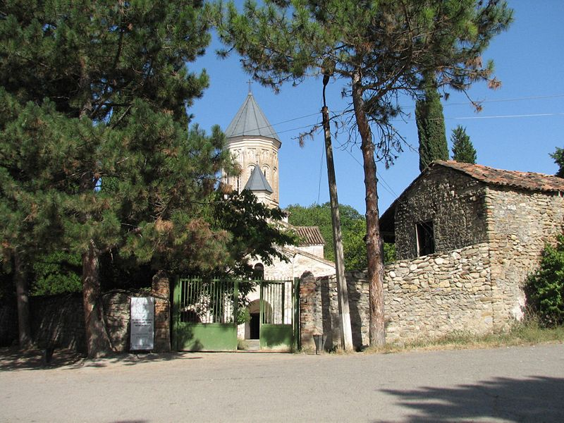
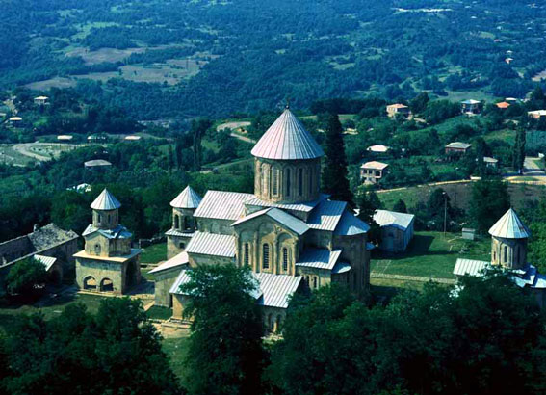
Ancient Higher Education institutions in Georgia (XI-XI c.)
Ikalto Academy
Gelatı Academy

Slide 3
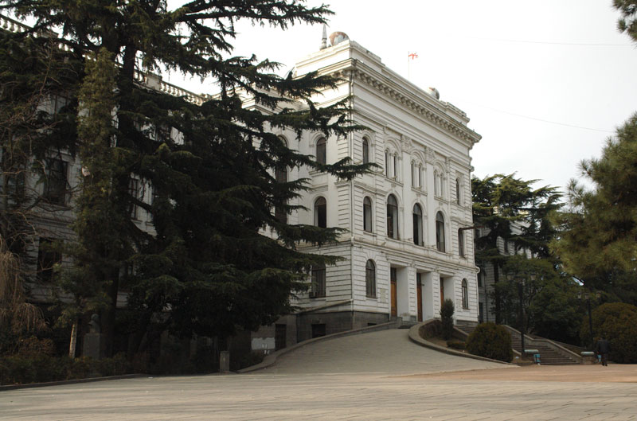
Soviet period

Slide 4
1991-2004
Private sector in education
Lack of control and quality
Outdated programs and educational materials
Efforts of education reform that caused a lot of protest as reform movement was a closed process
Bribery
Financing problems
No link with labour market
Lack of tranparency

Slide 5
Since 2005
Reforms in 3 directions
Equity of access to education
Quality through accreditation
New Law on Higher education
Unified National Admission Exams introduced
2005 membership in the Bologna process
National Center for Education Quality Enhancement
Mandatory accreditation and corresponding quality guarantee
Reintroduction of school exams but via Internet

Slide 6
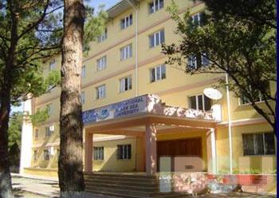
IBSU opened in 1995
Joint Georgian Turkish venture
Opened by President of Georgia and Prime minister of Turkey

Slide 7
Today at IBSU
Admission through Unified National exams on BA and MA levels
Transparency
Elected staff
Accreditation in 2006 and now authorization and accreditation
Resources
Tuition fees $ 2500=3700 in 10 installments up to 53% may be covered by state grants
Elite in quality not fees

Slide 8
Scientific budget
Silk Road Institute
Career planning office
By 2010 662 Bachelors 38 masters and 12 Doctors graduated 5 faculties/ compared to 2 faculties

Slide 9
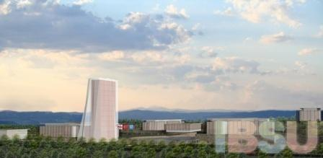
Thank you for attention

