Slide 1
The Kazakh automobıle-road institute by L.B.Goncharov
Dr.Sci.Tech.professorРабат О.Ж.
Cand.Tech.Sci. (Ph.D), Associane professor. Espayeva G.A.
Great Silk way in Kazakhstan

Slide 2
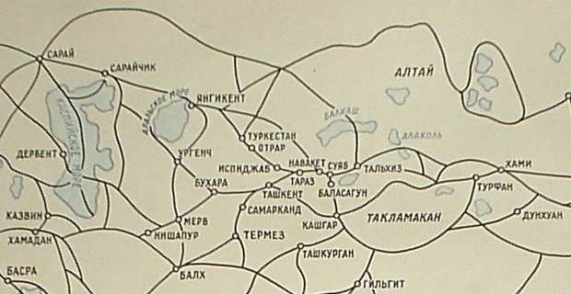
Great Silk way is a system оf caravans the roads conducting from China in the countries of the Near East and Europe. The considerable part of this piece lay on territory of Central Asia and Kazakhstan.
The silk way as a trading highway has arisen in III century B.C. and has existed till XVI century of our century.
In VI-VII centuries the way which lay from China to the west, through Semireche and Southern Kazakhstan becomes the most brisk. And special blossoming the Silk way passing on territory of Central Asia and Kazakhstan, has reached in VIII-XII centuries.

Slide 3
The great Silk Way was stretched on thousand kilometers, conducting caravans and on scorching deserts, and on oases, and on mountain passes. Throughout a way arose, blossomed and cities and the whole civilizations were devastated. Many devastating wars, destructions, big fires, hungers. Manycenturies annoised polyglots, markets of east rustled, Hundred years on dusty caravan roads merchants saled precious siens, stoes, spices and dyes, golds and silvers and e[etic birds. Proceeding from it, it is possible to tell that the Great Silk Way is the grandiose trading route which connected the East and the West and has become by the reason of occurrence of set of unique cities, historical monuments, customs and even the states.

Slide 4
The transcontinental corridor of Western Europe – the Western China should repeat binding glory of the Great silk way today.
The general extent of a corridor on a route St.-Petersburg — Moscow — Nizhni Novgorod — Kazan — Orenburg — Aktobe — Kyzylorda — Shymkent — Taraz — Kordaj — Almaty — Horgos — Urumchi — Lanchow — Cheng-chou — Ljanjungan makes 8,445 thousand in km. From them 2,233 thousand in km on territories of Russia, 3,425 thousand in km — China.
In Kazakhstan, within the limits of the reconstruction project is 2452 km. Thus in the Aktyubinsk area - 358 km., Kyzylorda area - 817 km., South Kazakhstan - 458 km., Zhambyl area - 480 km., Almaty-339 km. All order of 90 % of roads of the country.

Slide 5
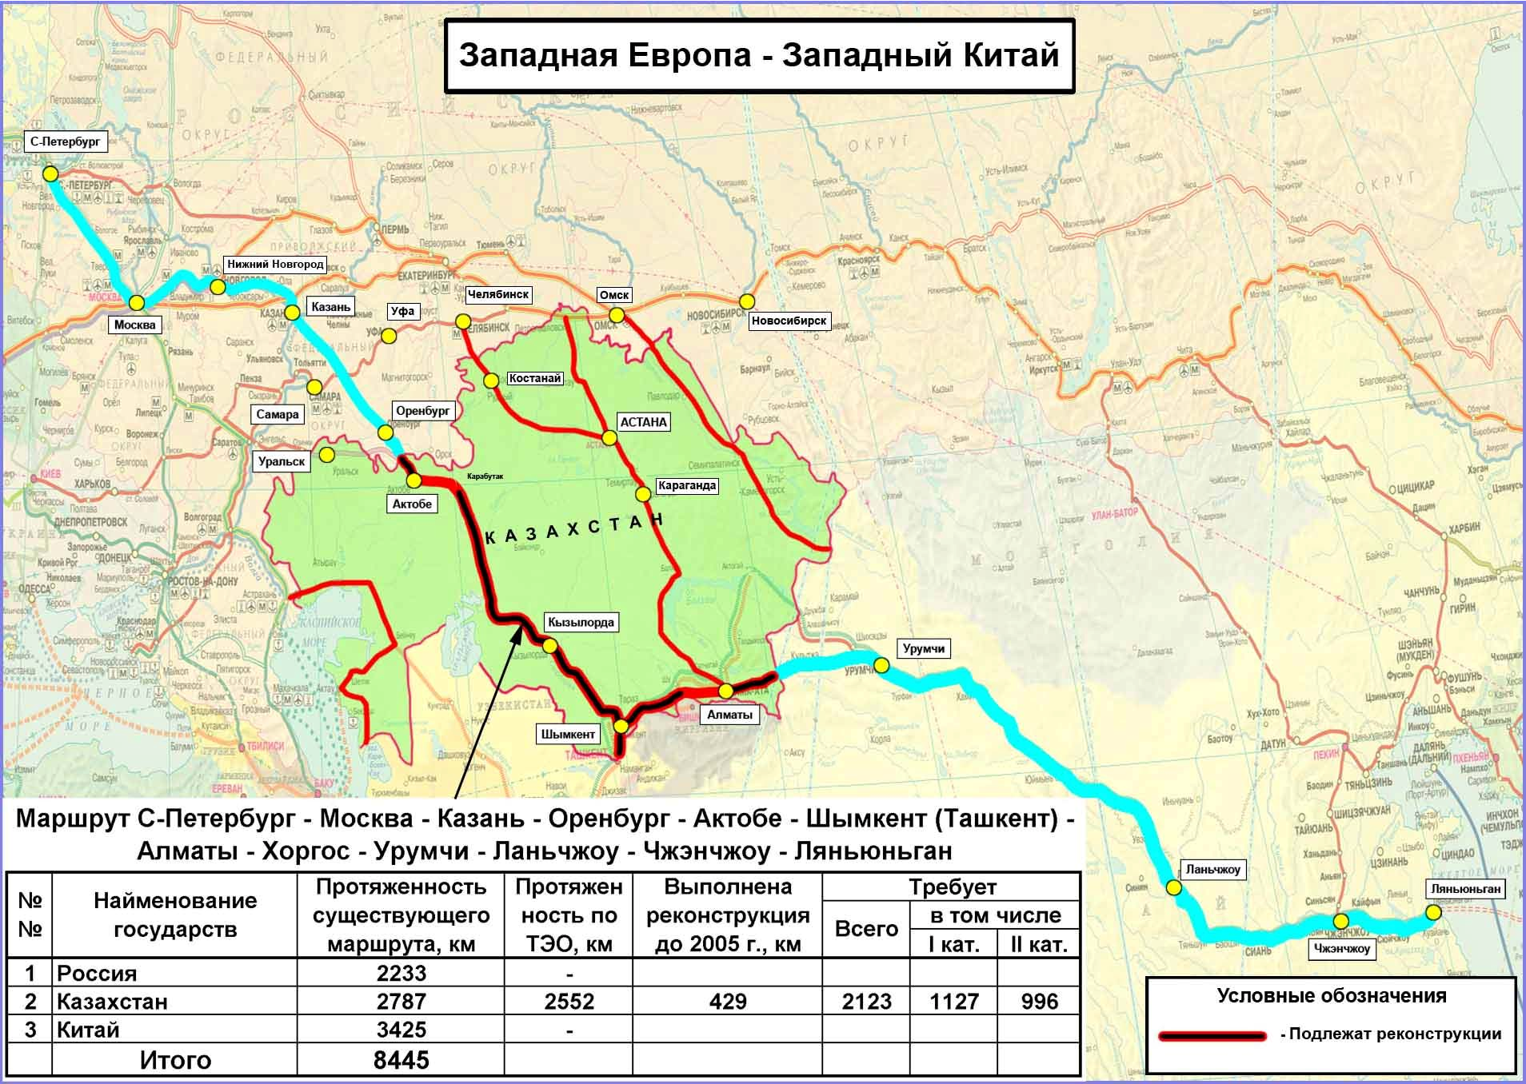

Slide 6
The basic positive indicators of the given project in comparison with existing alternative corridors (the road Trans-Siberian Railway, sea through Suez canal) is its extent and finding time in a way. If at use of a sea corridor finding time in a way reaches till 45 days, and on "Transibu" of 14 days along the corridor "the Western Europe - the Western China", from port Ljanjungan to borders with the European states, time in a way will make an order of 10 days. The project will provide a cargo transportation in three basic directions China - Kazakhstan, China - the Central Asia, China - Kazakhstan - Russia - the Western Europe.
The international transit corridor is «the Western China - the Western Europe» will be the basic route of a cargo transportation in the central-Asian region. The corridor will provide the high level of services including a combination of excellent technical availability of a corridor together with modern intellectual system and services of the logistical centers.

Slide 7
The Kazakh auto-road institute by L.B.Goncharova prepares experts in following specialities for road branch of Kazakhstan
Transport building (the Bachelor degree, the Magistracy)
Building (the Bachelor degree, the Magistracy)
Manufacture of building materials, products and designs
Transport, the transport technics and technologies (the Bachelor degree, the Magistracy)
The organization of transportations, movements and transport operation
Information systems
Economic specialities in road branch

Slide 8
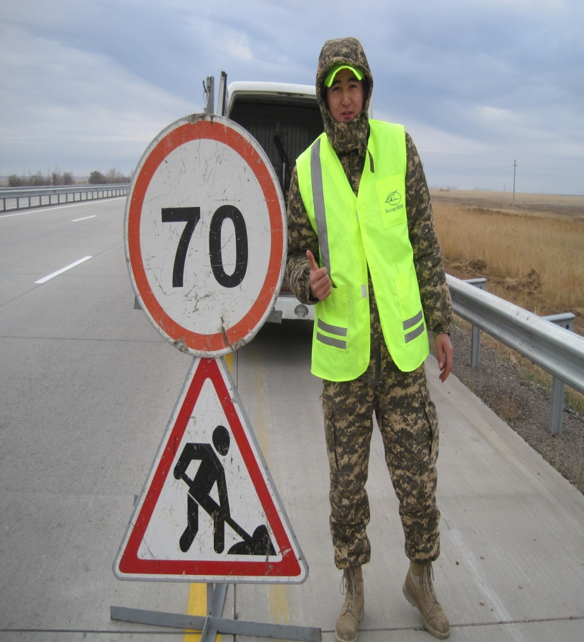
Students and undergraduates of the Kazakh automobıle-road institute will pass an industrial practice and take part in building of an automobile highway the Western Europe - the Western China in Zhambyl and Kyzylorda areas

Slide 9
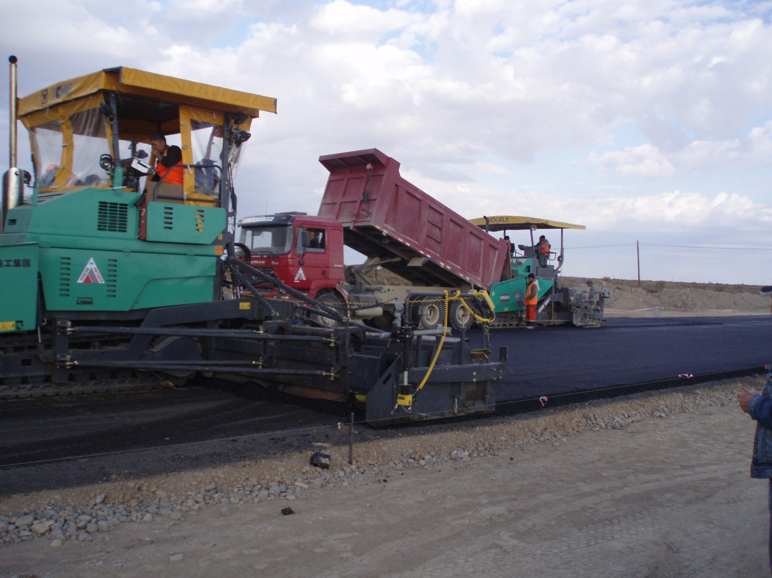

Slide 10
Highway building in Zhambyl area

Slide 15
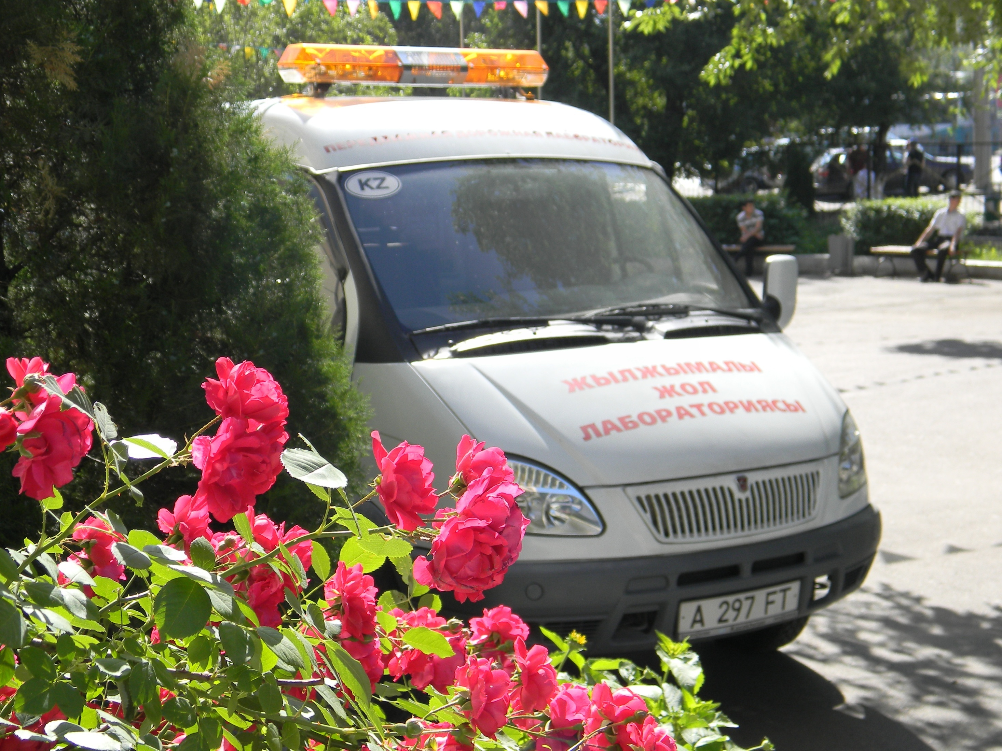
Научно-исследовательская работа
Для выполнения научно-исследовательских работ КазАДИ приобретены и сертифицированы стационарная лаборатория для контроля качества дорожно-строительных материалов и работ, передвижная дорожная лаборатория (на базе автомобиля «Газель») по оценке транспортно-эксплуатационных качеств дорог и безопасности движения.
Казахский автомобильно-дорожный институт (КазАДИ) им Л.Б. Гончарова в настоящее время имеет высококвалифицированный профессорско-преподавательский состав (ППС, 10 докторов наук, профессоров; 27 кандидатов наук, доцентов)

Slide 16
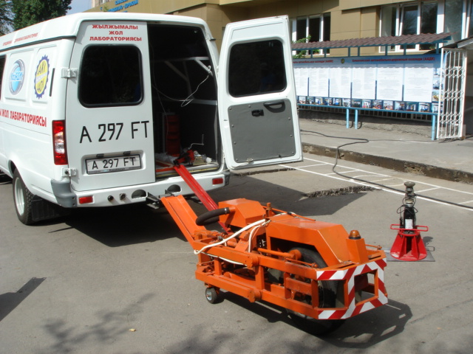
Mobile road laboratory PKRS-2U in working position

Slide 17
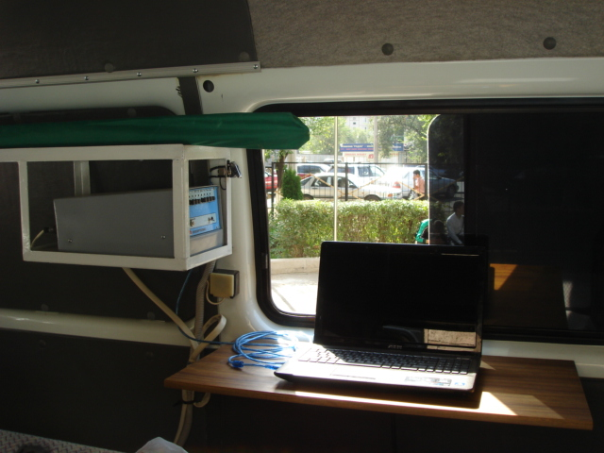
The block of management ПКРС-2У

Slide 18
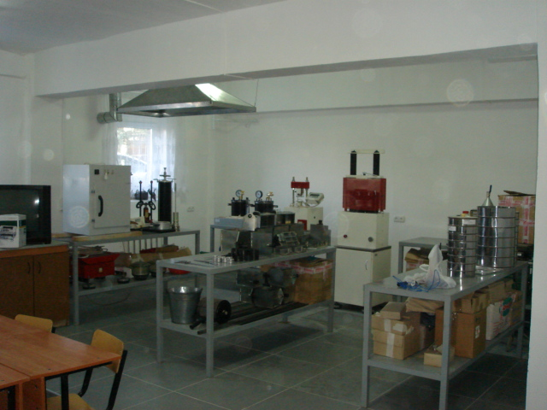
Stationary road laboratory KazAdI of L.B.Goncharov

Slide 19
In 2011 KazADI by L.B.Goncharov has won the tender and has started performance of works on certification and diagnostics of highways in Zhambyl area for 2 years (2264 km).

Slide 20
The international cooperation
Between KazADI of L.B.Goncharova and Association Howest of Gent university (Gent, Belgium), is concluded on June, 28th, 2010 the memorandum of mutual cooperation in the sphere of education, a science and researches (carrying out of joint research works, an exchange of students and teachers).
During official visit of the crown prince of Kingdom of Belgium Phillip to Kazakhstan was included memorandum of mutual understanding on opening of the Expert and coordination center in various areas, including formations and a construction of roads, between Association Howest of Gent university, the Kazakh auto-road institute of L.B.Goncharov and the Kazakh national-technical university of K.I.Satpaeva has been signed.
On October, 13th, 2010 the crown prince of Kingdom of Belgium Phillip has visited KazADI and has carried out start-up of interactive laboratory created together with Association of Universities of Gent Howest, Belgium - which was broadcast from Belgium, and coped in KazADI

Slide 21
Visit of the crown prince of Kingdom of Belgium Phillip in KazADI-13.10.10

Slide 22
Official start-up of interactive laboratory created together with Association of Universities of Gent Howest, Belgium.

